Slide 1
Predicting Fate of Passengers aboard HMS Titanic
Thinkful Supervised Learning Capstone
Ezra Zanger
https://github.com/ezzanger/Supervised-Learning-Capstones/blob/master/Capstone%20Unit%203.ipynb

Slide 2
Background - Titanic Data
In the year 1912 the HMS Titanic began its maiden voyage departing from Britain.
It was deemed unsinkable and as a result was not properly equipped with insufficient amount of lifeboats if the entire bot were to sink.
The ship’s passengers were divided into three classes beginning with class 1 being the most luxurious and expensive and class 3 the cheapest and mangiest.
Along the way to its destination in America the ship picked up passengers from 3 different cities (in order) – Southampton, Queenstown and Cherbourg.
On the tail end of its voyage, on April 14-15,1912 the Titanic crashed into an iceberg sinking the entire ship leaving few survivors.

Slide 3
Dataset Features
Featured are numerous prediction models utilizing some of the Titanic’s features such as the passengers’
Age
Ticket Fare
Class Number
Man, Woman or Child
City Departed
Alone
Survived
Many columns had missing data
Categorical features filled NaN with number 0
For column containing ages NaN for Numeric features were filled with the column mean
Binary features were manually encoded 0 and 1 from Y/N and T/F. Additionally binary and trinary features were used in expressing gender and adult or child.

Slide 4
Prediction Models Evaluated
Logistic Regression
KNN Classifier
Decision Tree
Random Forest
SVM Classifier
PCA was also applied and like models were compared as a validation technique for comparison

Slide 5
Model Evaluation Metrics
Train / Test Split
80 % Train / 20 % Test Split
Cross Validation
K-folds = 10
Classification Accuracy
Confusion Matrix
False Positive Rate
Precision

Slide 6
Sample of Titanic Dataframe
survived | pclass | sex | age | sibsp | parch | fare | embarked | class | who | adult_male | alone
0 | 0 | 3 | 1 | 22 | 1 | 0 | 7 | 0 | 3 | 1 | 1 | 0
1 | 1 | 1 | 0 | 38 | 1 | 0 | 71 | 1 | 1 | 2 | 0 | 0
2 | 1 | 3 | 0 | 26 | 0 | 0 | 7 | 0 | 3 | 2 | 0 | 1
3 | 1 | 1 | 0 | 35 | 1 | 0 | 53 | 0 | 1 | 2 | 0 | 0
4 | 0 | 3 | 1 | 35 | 0 | 0 | 8 | 0 | 3 | 1 | 1 | 1
5 | 0 | 3 | 1 | 28 | 0 | 0 | 8 | 2 | 3 | 1 | 1 | 1
6 | 0 | 1 | 1 | 54 | 0 | 0 | 51 | 0 | 1 | 1 | 1 | 1
7 | 0 | 3 | 1 | 2 | 3 | 1 | 21 | 0 | 3 | 3 | 0 | 0
8 | 1 | 3 | 0 | 27 | 0 | 2 | 11 | 0 | 3 | 2 | 0 | 0
9 | 1 | 2 | 0 | 14 | 1 | 0 | 30 | 1 | 2 | 3 | 0 | 0

Slide 7
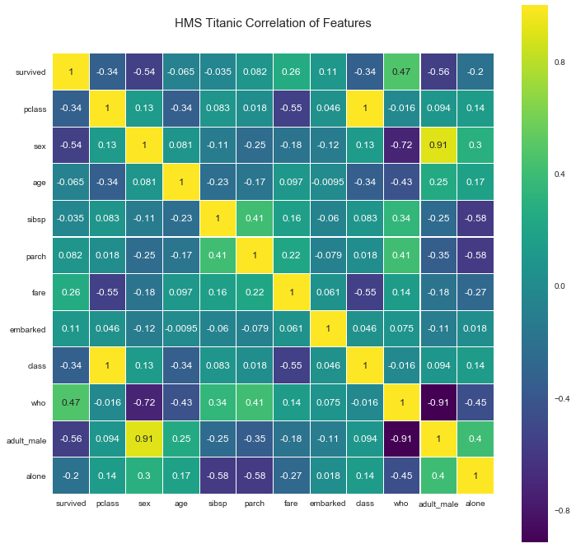
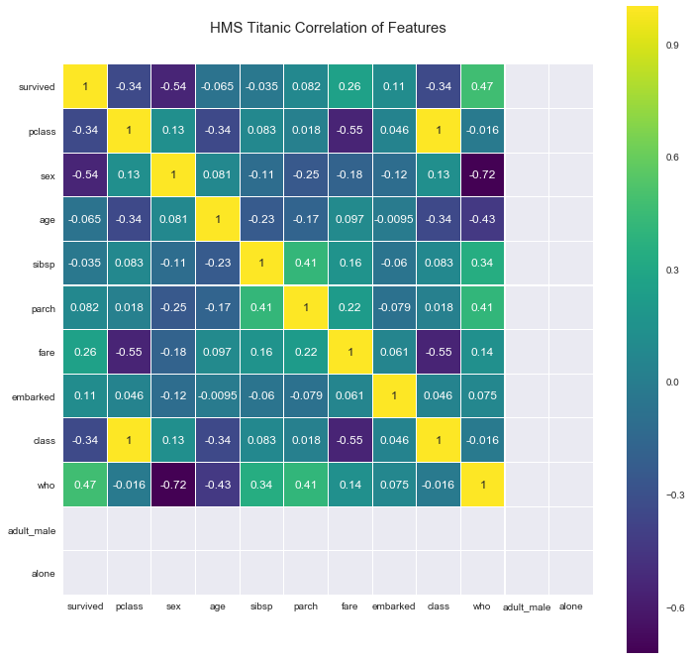
Correlation Heatmap of Titanic Dataset Features
High correlations that stand out are the relationship between
Survived and fare
Adult male and survived
Sex and survived
Fare and class
I think the most noteworthy correlation is featured regarding the relationship between survived and fare.

Slide 8
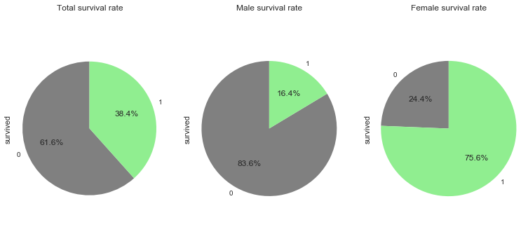
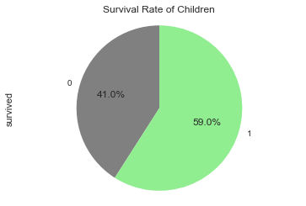
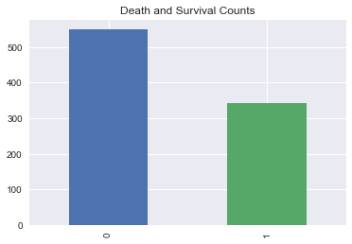
Survival Rates (Male, Female, Child and Total)
Featured are the survival rates per adult male, female and children. Additionally the histogram features the overall survivals and casualties of Titanic.
As expected there was a priority to make sure the weakest (women and children) were attended to before adult men.

Slide 9
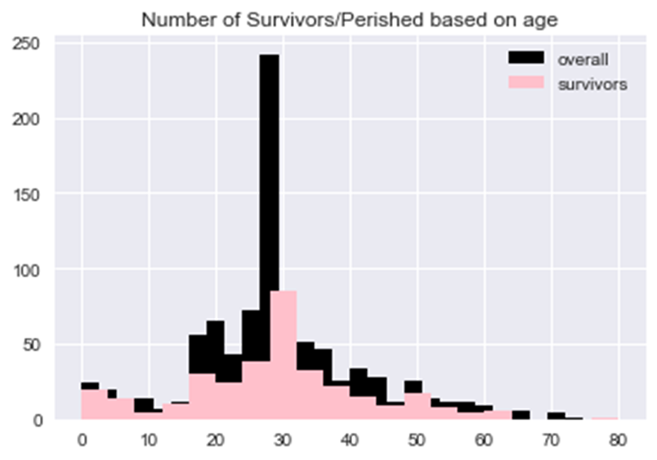
Barplot of Survived divided by age and gender (cont.)
This displays all the passengers by age and if they survived. Its worthwhile to note that although those between 25 and 30 survived the most, its only because they had the highest passenger volume to begin with.
The unproportional number of passengers from 25-30 is because these are unknown ages who were given the average age listed.

Slide 10
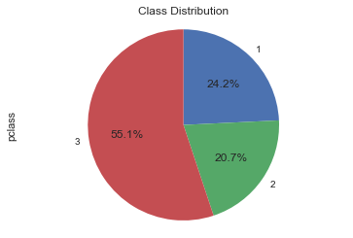
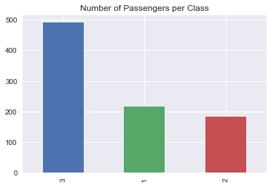
Distribution of Passengers based on Class
As portrayed in these graphs, the largest class was the third considering it was the most affordable. Naturally the second class was next in popularity followed by the first and most expensive class.

Slide 11
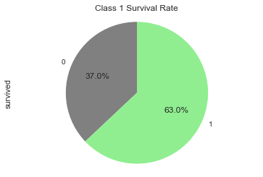
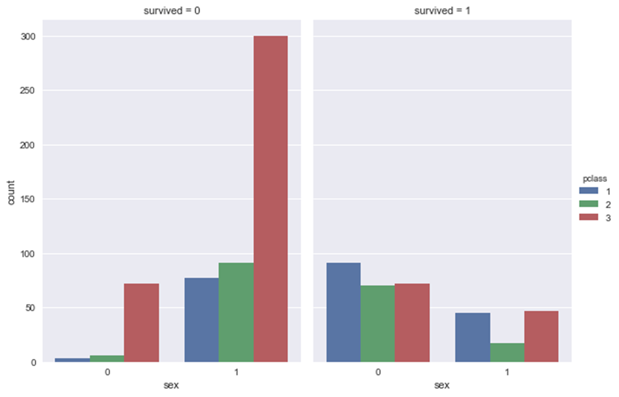
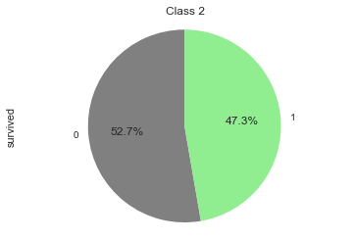
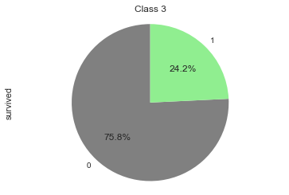
Survival Rate based on Class/Gender

Slide 12
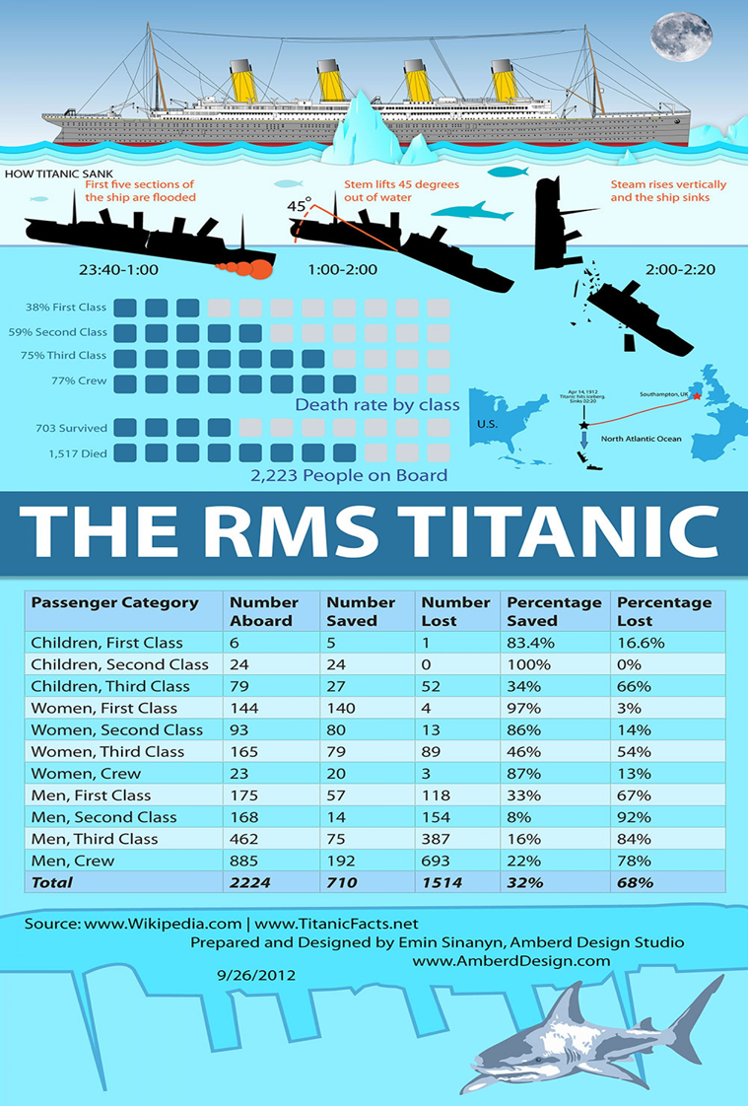
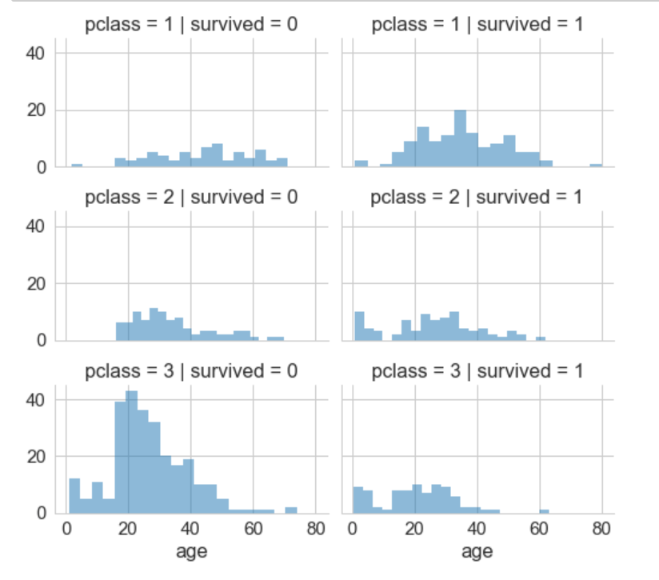
Summary of Class and Age Survival/Perished

Slide 13
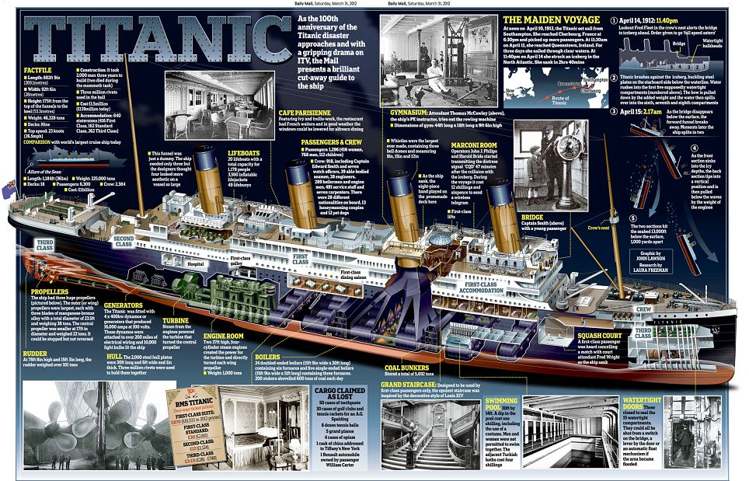
Here is a summary of all those who survived and died on the boat. As predicted earlier the rates of death were higher the lower the class. This can be due to a privileged status given to the richer or the because the first part of the ship to sink was that of the third class, but most probably the latter. Additionally, as predicted, rates of survival for women and children were higher than for men.

Slide 14
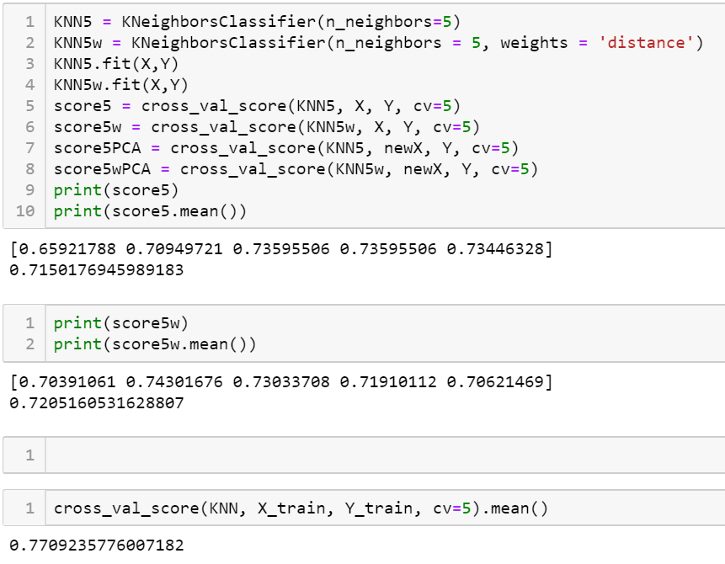
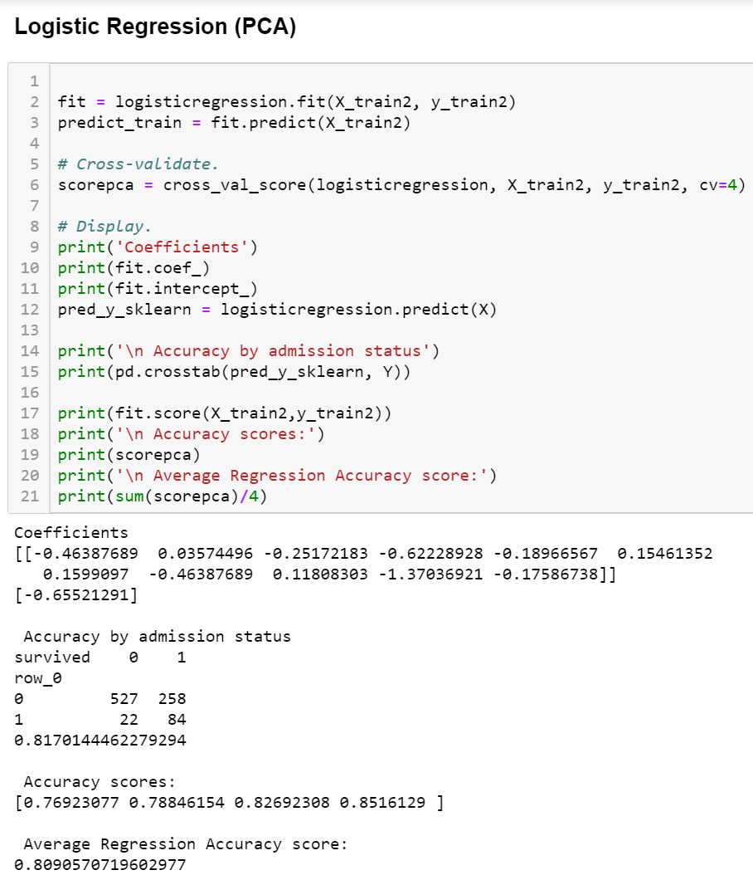
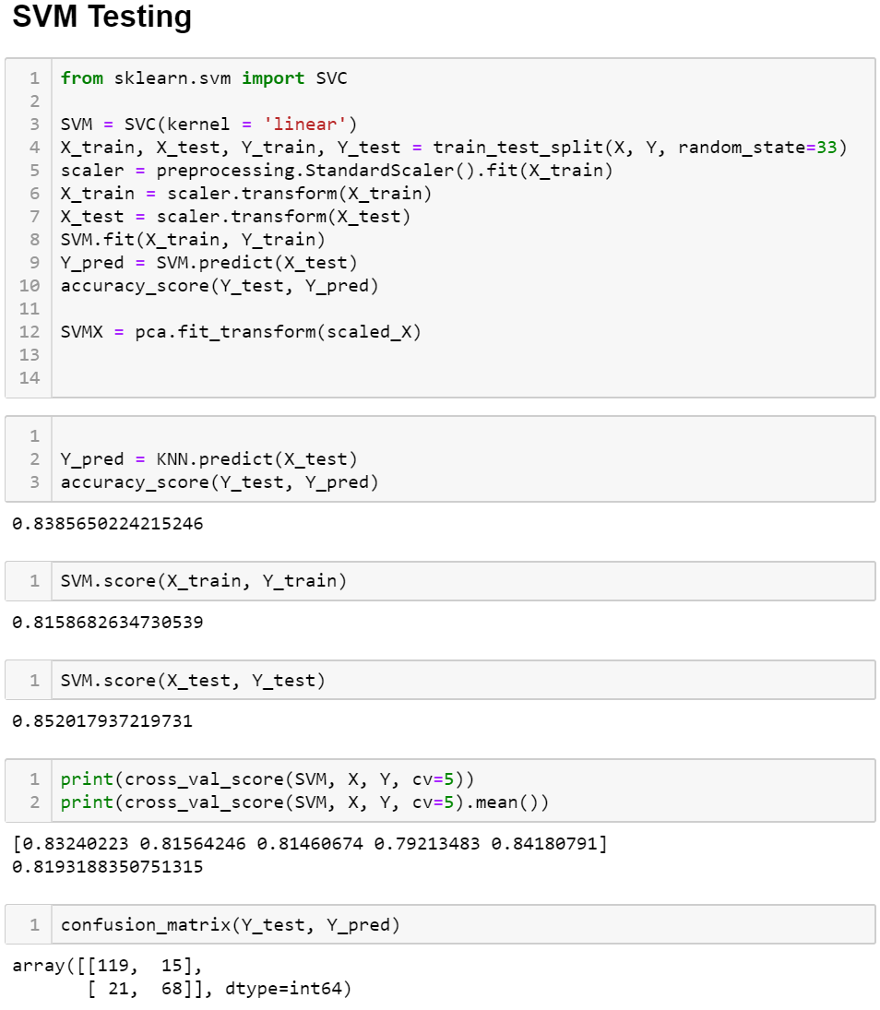
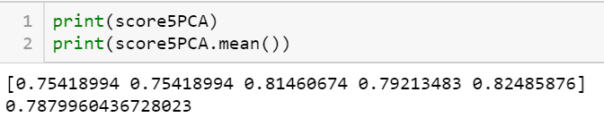
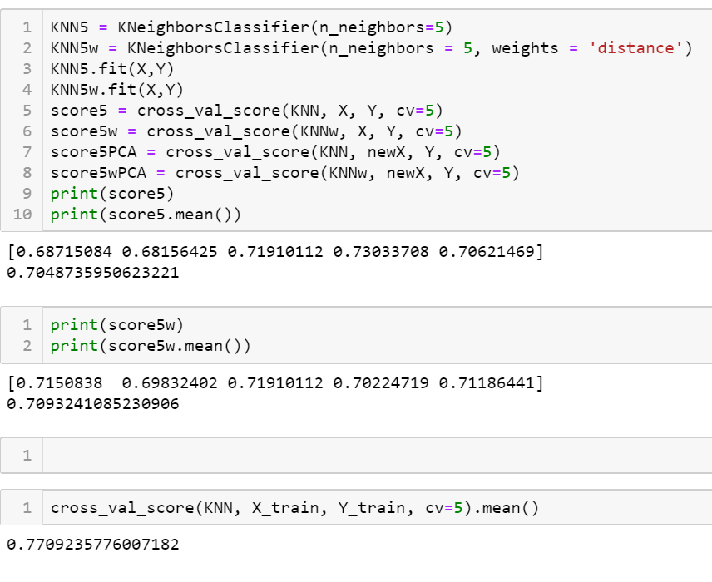
KNN Score k neighbors = 3 k neighbors 3 (weighted) 0.70391061 0.70949721 0.7247191 0.70224719 0.72316384] 0.7127075910343583
[0.67597765 0.69273743 0.73033708 0.7247191 0.70621469] 0.7059971905679401
K neighbors = 3 (PCA)
The KNN proved to work modestly resulting in an accuracy rate of 70% when implemented with 3 neighbors. When implemented with PCA, the KNN did considerably better but avoided overfitting.
[0.75977654 0.75977654 0.79213483 0.80337079 0.81355932]
0.785723602527425
K neighbors = 3 (PCA) (weighted)
[0.7597654 0.7418994 0.80898876 0.75280899 0.79661017] 0.7744748805494883

Slide 15

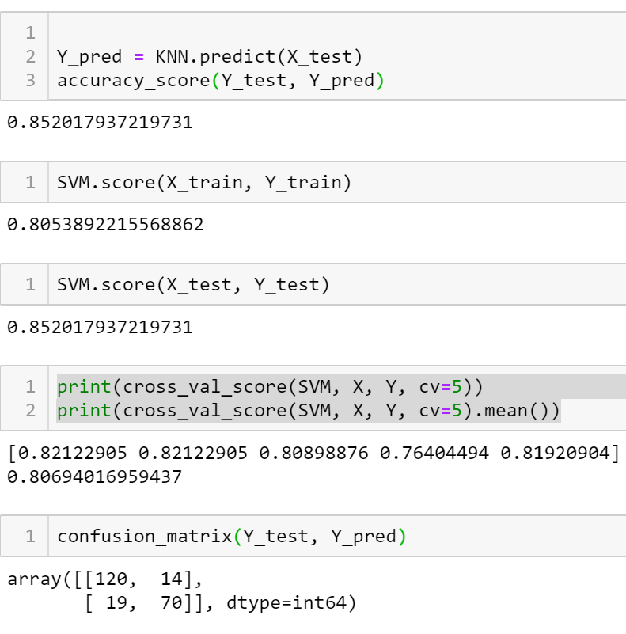
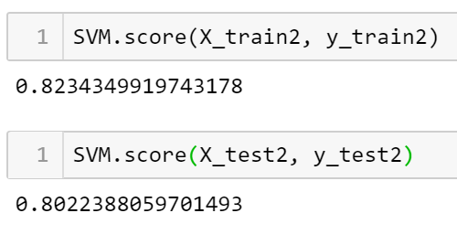
SVM Score
[
The SVM scores also fared moderately with the cross val scores/confusion matrixes providing close to a 80 percent accuracy rate. There was minimal increase when implemented with PCA.

Slide 16
Logistic Regression
The Logistic Regression fared just as moderately as the SVMs providing us with an average accuracy rate of 80% and an average of 82% when implemented with PCA
Coefficients
[[-0.38146653 -0.0125734 -0.3129827 -0.54369692 -0.30280143 0.28090903
0.13111229 -0.38146653 0.00641401 -1.37988379 -0.21154099]]
[-0.67601068]
Accuracy by admission status
survived 0 1
row_0
0 481 213
1 68 129
0.8143712574850299
Accuracy scores:
[0.83333333 0.82634731 0.79041916 0.79518072]
Average Regression Accuracy score:
0.811320130822692
Logistic Regression (PCA)
Coefficients [[-0.46387689 0.03574496 -0.25172183 -0.62228928 -0.18966567 0.15461352 0.1599097 -0.46387689 0.11808303 -1.37036921 -0.17586738]] [-0.65521291]
Accuracy by admission status
survived 0 1
row_0
0 527 258
1 22 84
0.8170144462279294
Accuracy scores: [0.76923077 0.78846154 0.82692308 0.8516129 ]
Average Regression Accuracy score: 0.8090570719602977

Slide 17
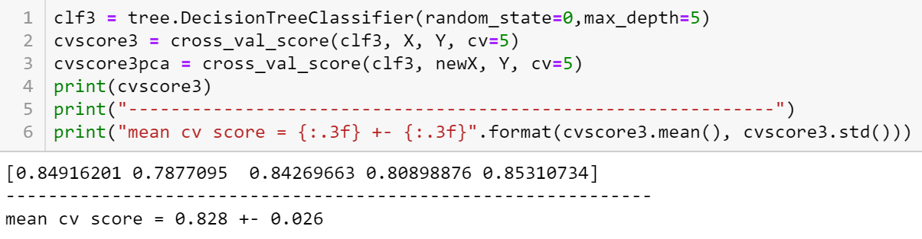

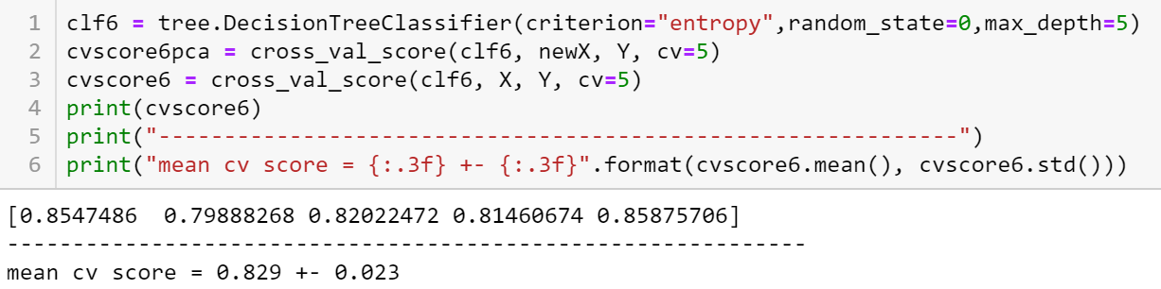

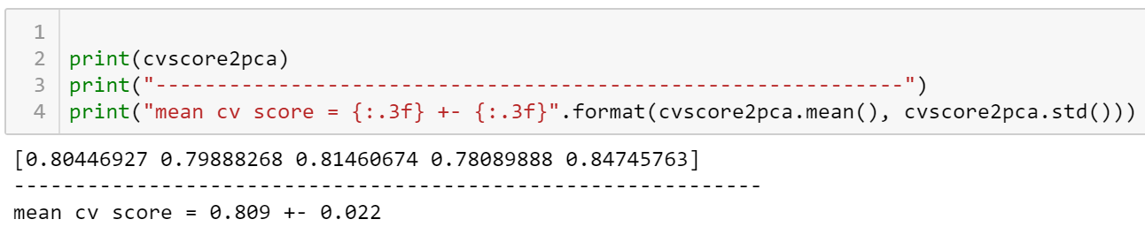
Decision Tree
Decision tree would be useful for this dataset since it contains both numerical and categorical data.
Featured are the best scores when implementing a decision tree. Due to the limited categories, a decision tree should fit nicely with this dataset.
The first decision tree produced a score of around .85, relatively high without a concern of overfitting. The max depth was 5. The PCA resulted in a lesser amount while a Decision Tree with entropy provided the same results as a regular Decision Tree.
Since this is a simple model a high KNN neighbor is in place even though it comes as the expense of variance.

Slide 18
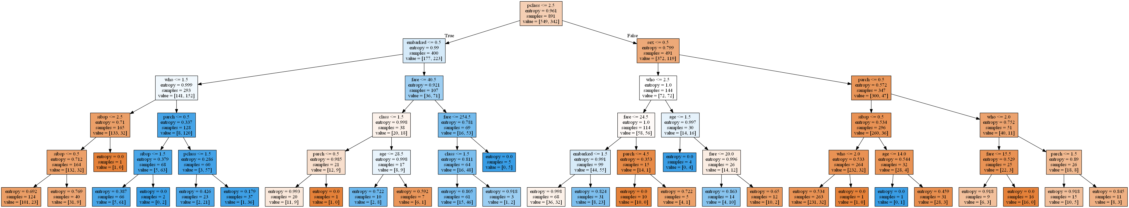
Decision Tree (displayed)

Slide 19
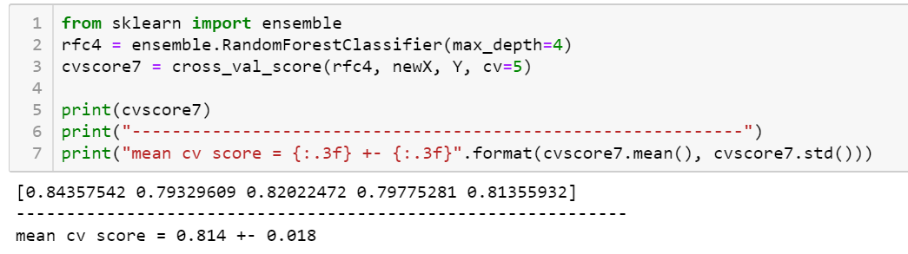

Random Forest
Random forests do a good job at curbing an overfitting that may be conveyed through a decision tree.
The best results from the random forest were a bit over .83, not as good as the decision tree preceding it.
This could be due to limited overfitting that provided such higher numbers earlier.
Similarly, the PCA model limits overfitting even more, providing a smaller number than if ran regularly.

Slide 20
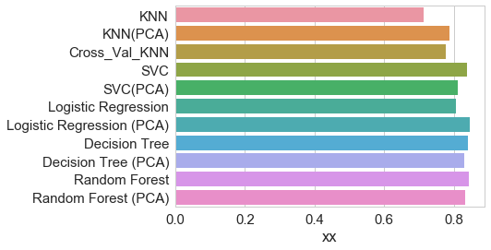
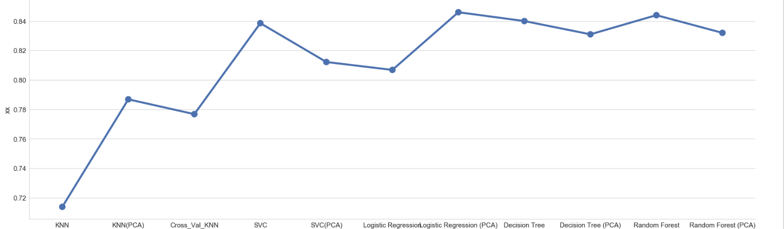
Classification Accuracy
Why do some perform better than others?
It seems Logistic Regression (PCA) provided the most accurate results followed by Decision Tree and SVC. This could be due to the binary nature of the dataset, enabling a logistic regression to be the most successful. The Decision tends to overfit a lot therefore might not have been best algorithim.

